Slide 1
Multi-Level Voxel Representation
By Gavin Young

Slide 2
Contents
Goal
Voxelization of Model
In-Out and Surface Normal Calculations
Rendering with In-Out and Normals
Multi-Level Model

Slide 3
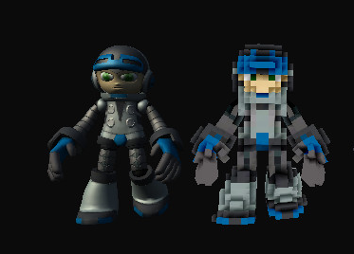
Goal
Voxelize CAD model (1st app)
Classify surface voxels
Calculate average surface normal in surface voxels
Output In-out and surface normal data
Render model using data from voxelized model (2nd app)

Slide 4

Voxelization of Model

Slide 5
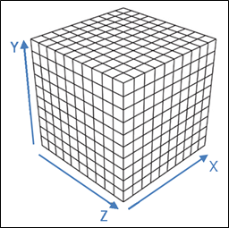
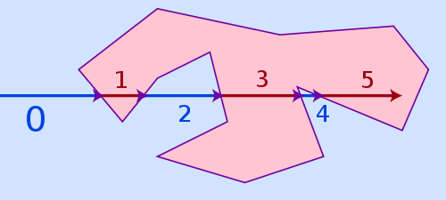
Voxelization
Generate voxels by using bounding box
User defines max voxels for a side
Ray cast to test for In-Out voxels
Store location of surface voxels
Draw voxels that are part of the model

Slide 6

Surface Normal Calculations
Classify Tessellation
Assign triangles to voxels
Vertex refers to vertex of triangle to be sorted
Test whether or not vertex has already been added
Go through voxels and calculate average surface normals

Slide 7
Rendering with Voxel Data

Slide 8
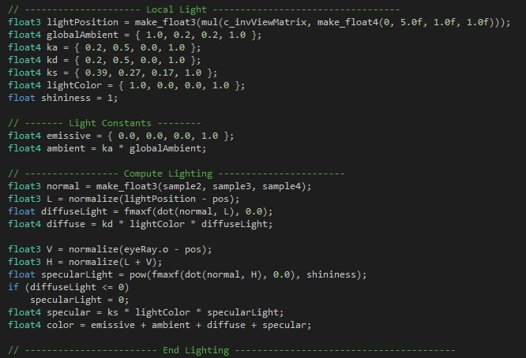
Reading Input Files
Have to input voxel grid dimensions
Put In-Out and surface normal data into arrays
Add lighting in CUDA to calculate color

Slide 9
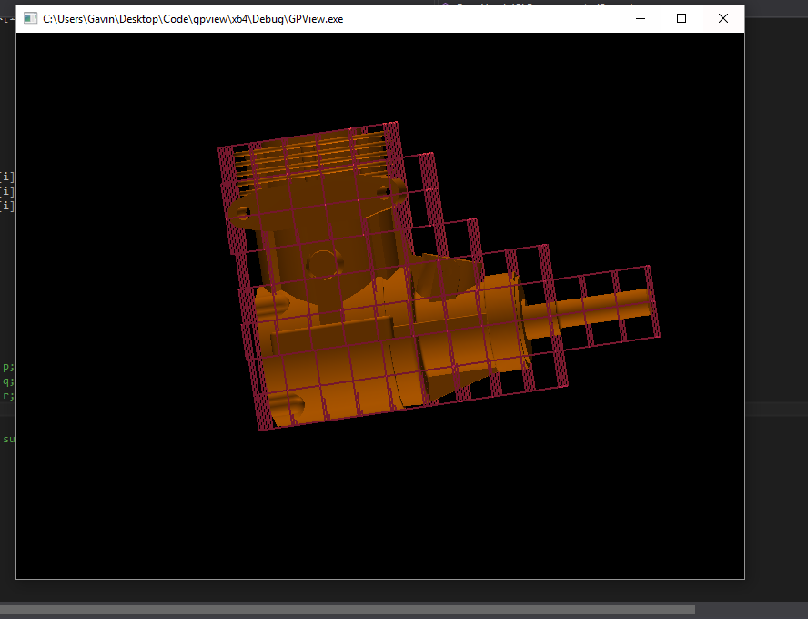
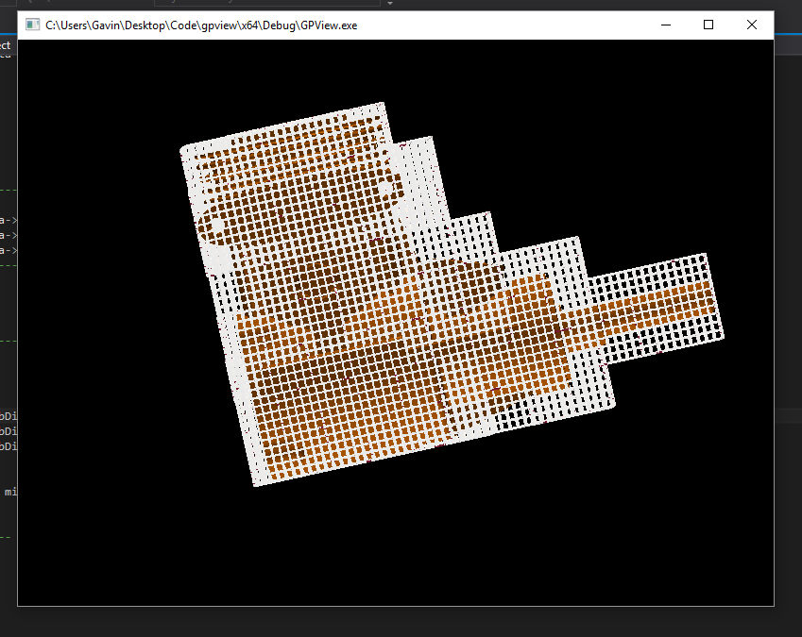
Multi-Level Model

Slide 10
Future Work
Voxel Model
Index all surface voxels
2nd level grid assigned to specific index
Output surface voxel indexes and 2nd level data
Rendering Model
Add new inputs
When reading a surface voxel data read 2nd level data instead

Slide 11
Questions??

